Slide 1
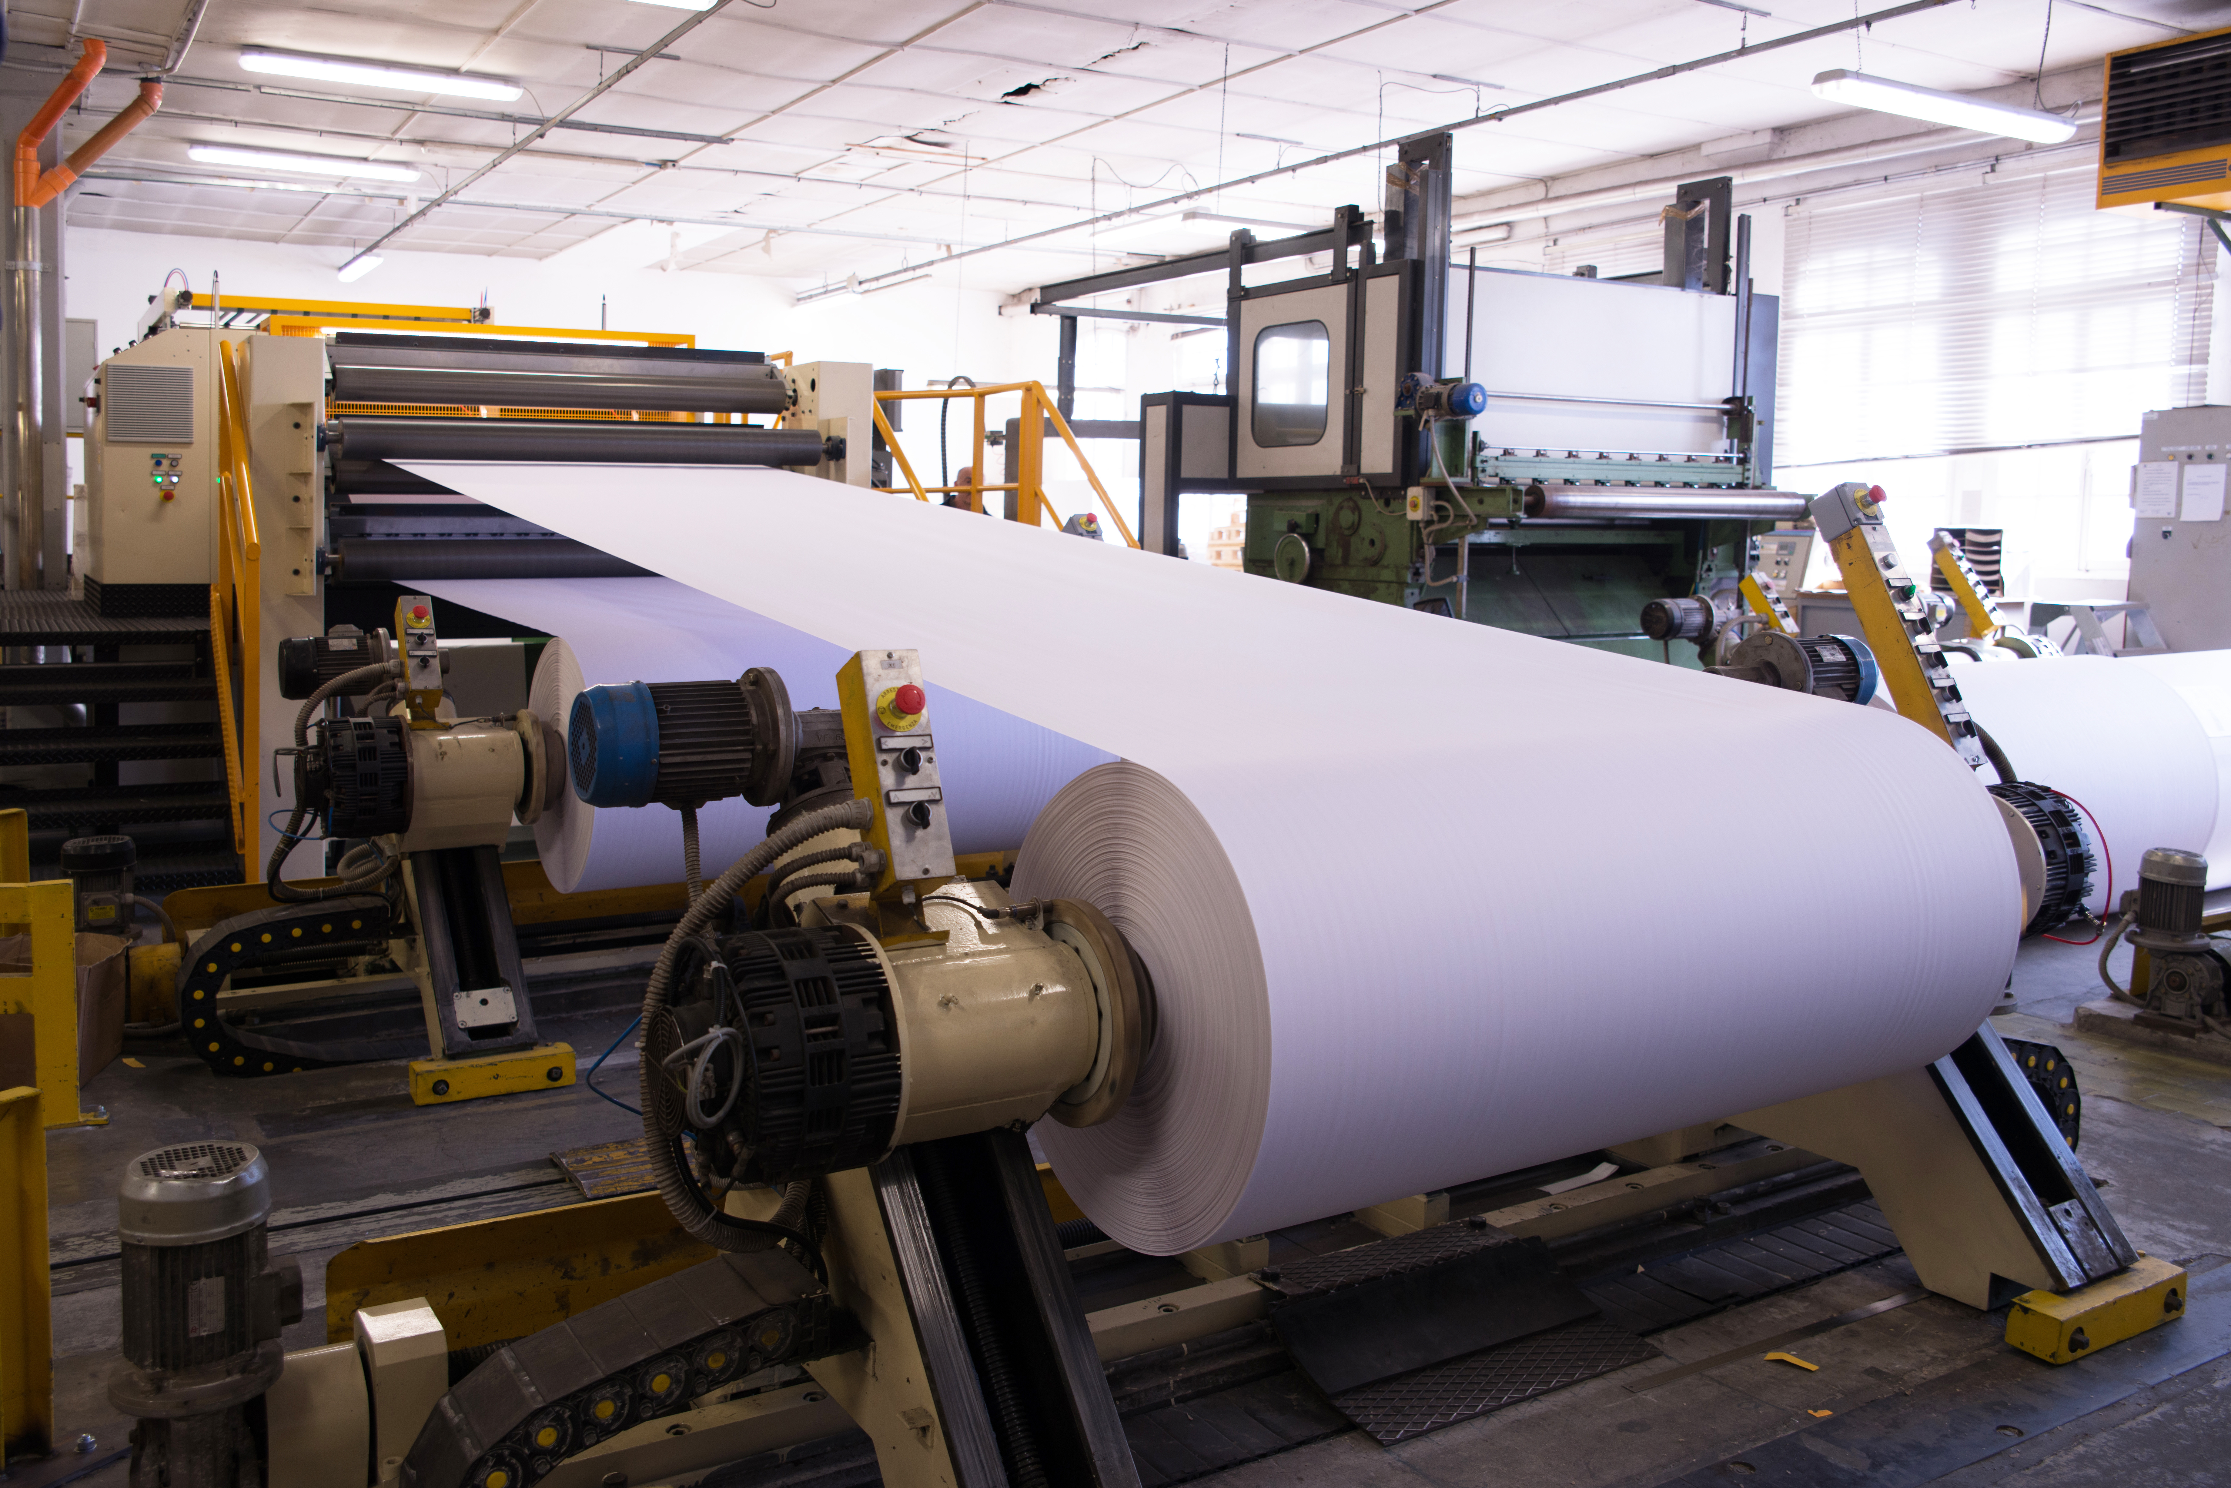
<Company Name>
Technical Solution Design

Slide 2
High-level functional requirements
<Example> An app for managing buying events with suppliers to reduce the total time taken for individual events and for supplier optimization

Slide 3
Solution approach
 | Requirement | Solution
1 | An app for managing buying events with suppliers to reduce the total time taken for individual events and supplier optimization | <Example> SAP Fiori app through which ECP employees can buy from suppliers. Features should include: Option to choose a supplier based on comparative evaluation

Slide 4
Design considerations from Design Thinking Exploration
Empathize – Define – Ideate – Prototype – Test
<Name of the app>
<Design considerations based on persona>

Slide 5
Solution diagram
<Highlight the various systems/applications and data flow>

Slide 6
Considerations/Assumptions
<Example> IoT devices should be implemented on equipment to receive operational data as input for analytics.

Slide 7
To-do before Realize phase

Slide 8
Product backlog

Slide 9
Thank you!

